Slide 1
Slide Set 4
Polymorphism: Classification of Polymorphism, Compile time and Run time Polymorphism, Pointers to derived class object, Virtual functions, Pure virtual functions.

Slide 2
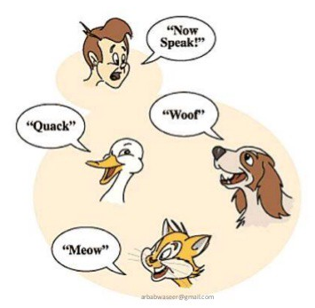
Polymorphism
Poly means many and morph means form

Slide 3
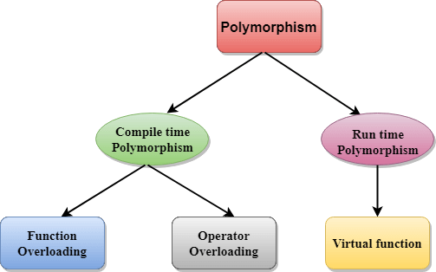

Slide 4
Overloading vs overriding
Function overloading – same function name but different arguments. Functions are defined in the same class.
Function overriding – same function name and arguments. Defined in different classes.

Slide 5
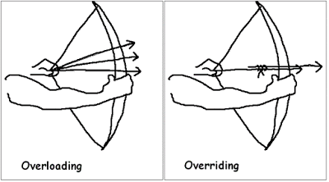

Slide 6
Compile time and Run time Polymorphism
Compile time OR static polymorphism is executed using function overloading.
Run time polymorphism or dynamic/late binding is done using function overriding and virtual functions.

Slide 7
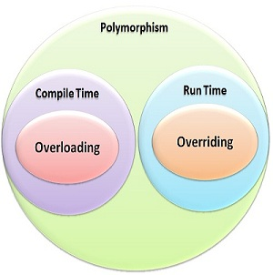

Slide 8
Virtual function VS pure virtual function

Slide 9
Example – Virtual Function
class Base {
public:
virtual void msg() { cout<<" In Base \n";}
};
class Derived: public Base {
public:
void msg() {cout<<"In Derived \n";}
};
int main() {
Derived d; Base *b;
b = &d; b->msg(); // Output: In Derived
}

Slide 10
Example – pure virtual function
class Base {
public:
virtual void msg() = 0;
};
class Derived: public Base {
public:
void msg(){ cout << " In derived class"<<endl; }
};
int main() {
Base *b; Derived obj;
b = &obj; b->msg(); // Output: In derived class
}

Slide 11
Shorter is better (same output for previous programs)
int main() {
Base *b; Derived obj;
b = &obj; b->msg();
}
int main() {
Base *b = new Derived;
b->msg();
delete b;
}

